Slide 1
Microsoft Office Made Easy
Presented by
Greg Creech
Microsoft Certified Application Specialist – Instructor
CompTIA Certified Technical Trainer +
A Nutty Professor!

Slide 2
Keyboard Shortcuts – Still the Best!
I have used keyboard “shortcuts” before they were shortcuts – that was our only option in 1981.
With many ways to access commands, keyboard shortcuts are still very popular.
Each application offers help and support on tons of keyboard shortcuts.
Keyboard shortcuts cross many applications and platforms, such as CTRL + C to copy, CTRL+V to paste.
Visit gregcreech.biz for my favorite shortcuts.

Slide 3
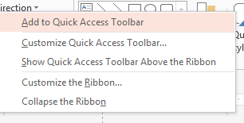
Quick Access Toolbar
Located at the top left part of your title bar by default with only a few buttons (thank goodness Undo is one of them),
Customize the toolbar by right clicking a tab and from the menu select Customize Quick Access Toolbar or through the File tab and Options,
Saves time by remaining constant and retains your favorite commands,
Customize for each application,
Add commands not in the Ribbon, such as Speak,
Show above or below the Ribbon,
Quickly add buttons from the Ribbon to the Quick Access Toolbar by right clicking the button.

Slide 4
Favorite Commands
Using the Customize Quick Access Toolbar pane and All Commands and Popular commands in the Choose commands from box I add common commands, like New file, Save As, Format Painter,
I add buttons for each application including:
Sort, Filter, and Freeze Panes in Excel,
Animation Pane, Change Shape in PowerPoint,
AutoCorrect, Speak, Page Set-up in Word.

Slide 5
Customize Ribbon
Customize the Ribbon – Create your own tab with your favorite commands plus change the button picture and name,
Customize for each application,
Add commands not in the standard Ribbon, such as Speak,
Activate or deactivate tabs through Customize the Ribbon,
Interface is similar Quick Access Toolbar.

Slide 6
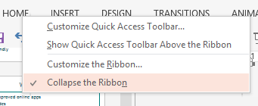
Ribbon Display Options
Ribbon Display Options are on the right of your Title bar – next to help,
Auto-hide takes you to a full screen view and to retrieve the ribbon you must click at the top of your screen,
You may collapse or expand the Ribbon using these four methods:
Use the Ribbon Display Options pane,
The CTRL + F1 keys,
Double clicking the active tab’s title,
Right click on a tab for the shortcut menu.
Notes:
The Backstage view opens from the File Tab. This is called Backstage because none of the Ribbon tabs are visible and you cannot edit your file, so you are backstage. A feature I like using having my last number of documents visible in the navigation pane of Backstage view. This is set as shown below through your Options button, the Advanced item, and the Display section.

Slide 7
AutoCorrect
Automatically corrects misspellings and saves text shortcuts for ease and accuracy,
AutoCorrect is under File > Options > Proofing > AutoCorrect Options or in Word and PowerPoint when the app uses AutoCorrect an icon appears:
Word stores more than 65,000 characters and is great for creating documents with a quick short cut,
Save symbols, phrases, and convert lowercase to UPPERCASE for acronyms.

Slide 8
Speak!
Each Office applications offers the Speak command, but it is not in the Ribbon,
In customizing your Quick Access Toolbar, you may use the Command From box and the Commands Not in the Ribbon item to add speak,
Speak reads allowed whatever you select (Word paragraphs, documents, Outlook email’s selected text, Excel cells, rows, and columns),
Does not turn itself on, you click the button to have your computer speak your selected text and click it again to turn it off.

Slide 9
Welcome Back!
Word and PowerPoint have a new box when you open a saved file that you recently edited,
Welcome back allows you to return to where you were editing your document,
Great for quickly navigated from the beginning of your file,
The dialogue box tells you the section where you left off.

Slide 10
AutoText in Word
AutoCorrect forces itself on you; AutoText suggests its entry for you to press enter to accept the suggestion,
You may save text after selecting it in the Insert tab and the Text Group and clicking the AutoText button which displays a pane with your AutoText entries and at the bottom Save selection to AutoText Gallery,
If you begin to type a date in Word, AutoText will display today’s date to insert by pressing enter,
After saving your entries, Word will use AutoText after the first few characters.

Slide 11
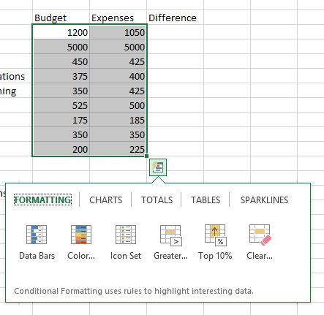
Excel Quick Analysis
Selecting an area produces a shortcut button for you to click and receive a menu,
The selected area determines how well this works for you,
Formatting produces Conditional Formatting,
Charts creates a chart based on your selection,
Totals offers Sum, Average, Count, Percents,
Tables produces Format as a table for you and aids in sorting and filtering information,
Sparklines are quick graphic analytical tools – similar to a basic chart.
Notes:
The Design Tab in Word affects your entire document and the new Paragraph Spacing Dialogue box appears below. Changing the paragraph spacing here or inserting a watermark updates your file for you. You may create your own custom theme for headings, colors, fonts, and other elements. You may create you own color and font schemes as well using the Design tab and associated command buttons.

Slide 12
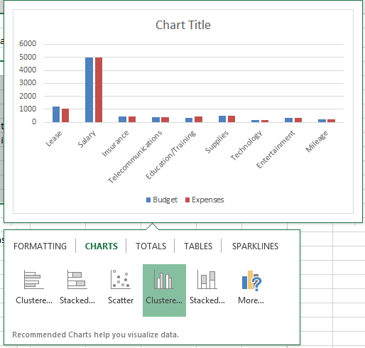
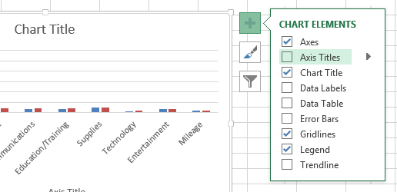
Recommended Charts and Shortcuts
Using the Quick Analysis Toolbar and the Charts section, you may choose a chart to accompany your selected information,
IMPORTANT! Selecting the area or data to base your chart upon is critical to receiving a helpful chart,
After inserting your chart you may add/delete elements, change formatting, and filter your information with shortcut keys as displayed here.
Notes:
The Design Tab in Word affects your entire document and the new Paragraph Spacing Dialogue box appears below. Changing the paragraph spacing here or inserting a watermark updates your file for you. You may create your own custom theme for headings, colors, fonts, and other elements. You may create you own color and font schemes as well using the Design tab and associated command buttons.

Slide 13
AutoFilter
Add the AutoFilter button to your Quick Access Toolbar or a tab in the Ribbon (part of All Commands in the Customize Quick Access Toolbar pane,
Select an item in an Excel table, click this button and Excel turns filters on and filters your table based on your selected cell,
You may right click on a cell from the shortcut menu choose filter and then filter based on selected cell’s value, too.

Slide 14
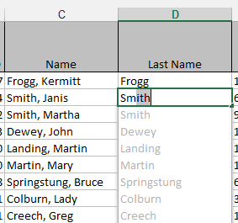
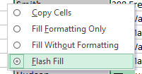
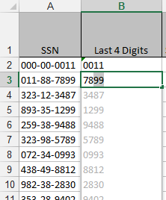
Excel Magic - Flash Fill
Completes series for you – Combines AutoComplete and Text-to-Columns features for you with the magic of Fill,
Great for text, text as numbers, dates, and so on,
Insert a column, enter a couple of items, and Excel produces a “gray” list of items it believes you want to use – press enter to accept Flash Fill,
Use the Fill Handle to produce the Flash Fill option in the Fill Handle option for your list, too,
You may need to format the column as text.

Slide 15
Animation Painter
Similar to Format Painter,
Copies animation from object to another object,
Select the object that you wish to copy and click the Animation Painter,
Next, click the object that you wish to use the animation,
Double click the Animation Painter to paste multiple objects,
Press ESC key or click the Animation Painter button again to stop pasting.
Notes:
Animation Painter
Click in your animated Title Box and Click the Animation Painter. Notice in the screenshot and the tip that you may double click your Animation Painter to keep it on to automatically animate other text and objects in your presentation.
✵ If you want to turn off the Animation Painter you may press the ESC key on your keyboard or click the Animation Painter button again. 
Next click your Sub-Title Text Box to apply the animation effect to your Sub-Title. This is like using copy and paste on text, but the animation painter copies and pastes your animation.
Next click your Slide Show view at the lower part of your screen and Press Enter or Click to see your animated text in the Slide Show.
Press the ESC key on your keyboard to return to edit your slide.
Next, Animate your Bullet List on Slide Two. I am choosing Wipe and changing my direction to Left.

Slide 16
Transitions Tab
Animation is movement within a slide,
Transition is movement between slides,
Similar to animation you choose a transition and use Effect Options,
You may change the speed of your transition using the Duration box,
You may use the same transition for your presentation (using the Apply To All button) or use different transitions for each slide,
Like animation, you may activate your transition on a mouse click or automatically move through the slide(s) using the After box.
Notes:
Transitions
Click the Transition Tab. In the Transition to This Slide section scroll through the Gallery and Preview the different types of transitions you may have.
Choose a transition and click the Apply to All button and perhaps change your speed. For humor, you may give a transition sound; however, I would avoid having a sound transition on every slide.
Click your preview icon to see your transition or click the Slide Show View button to see your presentation in slide show and click to advance through your presentation. As with Animations, you may use the Effect Options menu to change direction and other items based on the effect you choose.

Slide 17
SmartArt
You may add SmartArt for diagrams in the Office applications using the Insert Tab,
SmartArt has many types of diagrams, charts, and graphics, such as Pyramid, Cycle, Hierarchy,
You may use the Text Pane or type directly into the SmartArt objects to enter text,
Use SmartArt’s Design and Format tabs to change your layout, colors, and other items to enhance your diagram.
Notes:
SmartArt in PowerPoint
You may add SmartArt for diagrams to PowerPoint using the Insert Tab or the Content pane for some of the layouts,
SmartArt has many types of diagrams, charts, and graphics, such as Pyramid, Cycle, Hierarchy,
You may use the Text Pane or type directly into the SmartArt objects to enter text,
Use SmartArt’s Design and Format tabs to change your layout, colors, and other items to enhance your diagram.

Slide 18
SmartArt - My Sales Cycle
Meet and Greet The Client
Data Gather
Make Proposal
Schmooze & Booze The Client
Close the Sale or Choke the Client!
Celebrate!
Repeat if necessary
Notes:
Click the New Slide button on the Home Tab and from the menu Choose Title and Content as your slide.
Add a Title – I have typed: Our Sales Cycle.
Click the Insert SmartArt Graphic item in the Center of your Slide or use the SmartArt Button on the Insert Tab. PowerPoint activates the SmartArt Graphic gallery with many diagrams, charts, and graphs to select. Scroll through and notice all of the neat ways of displaying your information PowerPoint offers.
I will use the Basic Cycle for my SmartArt Graphic. Choose your diagram and click OK.
An outline of your diagram appears on the Slide.
The SmartArt Tools tabs appear for you when you are working on your graphic. SmartArt Tools include the Design and Format tabs which you will use to change your diagram and customize the Cycle. The SmartArt tools allow you to Change your layout, Change the type of Diagram and other items.
Next – Click in each text box and type your process or other words describing your items or you may use your Text Pane.
Click in your Diagram and from the Design Tab click the Change Colors button. From the gallery choose a color scheme you desire. After choosing a color, next choose a style using the SmartArt Styles gallery. Click each one and then choose a style of your liking.
Click your Slide Show icon to display your beautiful Diagram Slide.

Slide 19
Multimedia
PowerPoint supports many file formats for multimedia, including videos and sound files,
You play videos from your device or from other websites, such as YouTube,
Sound files may be music, voice overs, sound effects, and other types,
PowerPoint supports many formats and plays your sound and video within the application.
Notes:
Multimedia
PowerPoint supports many file formats for multimedia, including videos and sound files,
You play videos from your device or from other websites, such as YouTube,
Sound files may be music, voice overs, sound effects, and other types,
PowerPoint supports many formats and plays your sound and video within the application.

Slide 20
Our Newest Associate Video Example
Notes:
Inserting a Video File
On your Home Tab, click the New Slide button and from the cascading menu choose Title and Content slide. You can insert a movie as we have accomplished using the Insert Tab and Movie Button.
PowerPoint creates our familiar Title and Content slide and the Insert Media Clip appears on the bottom row and right button.
Give your slide a title; I am entering Our Newest Associate.
Click the Movie Reel or Insert Media Clip button.
Navigate to where you store your video files. I am using the New Age Secretray.wmv file. In the Files of type section notice all of the media and movie formats you may use. Click OK.
In 2007 PowerPoint, Click Automatically at the next dialogue box as we have accomplished previously. Skip this step for 2010 and 2013 as it will not provide this dialogue box.
PowerPoint inserts the movie for you.
Using the Playback Tab you may edit your video with trimming and fades, and decide how to play your video.

Slide 21
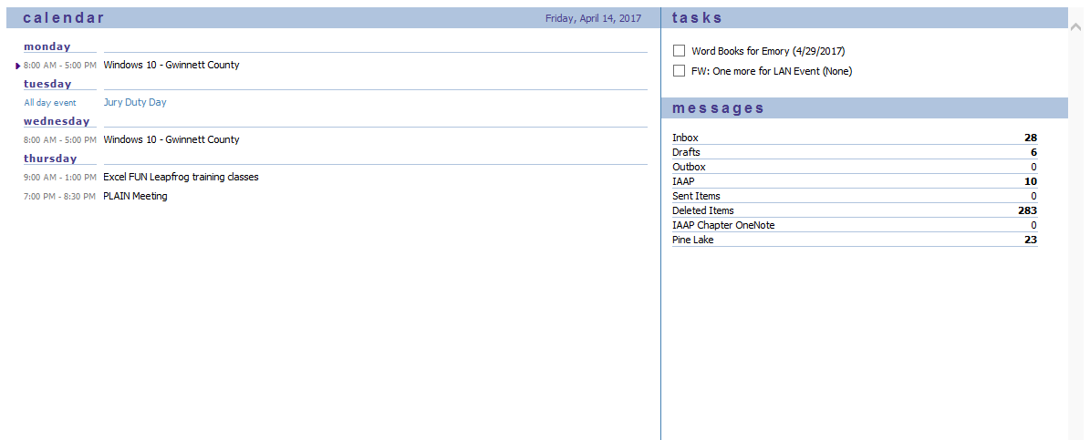
Outlook Today
Outlook Today is your top level folder above your Inbox,
Displays your calendar for up to seven days, your tasks, and favorite folders,
You may customize Outlook Today to open when you start Outlook using the Customize Outlook Today button,
Using the Customize Outlook Today pane you may change your theme and number of days to show on your calendar.
Notes:
Outlook Today
Outlook features a nice tool entitled Outlook Today. The Outlook Today feature displays the Outlook Navigation bar, your Calendar entries, Tasks, and number of new messages in your common mailbox folders (In, Out, and Drafts). With Outlook Today automatically opened at startup, you may view your week or days ahead on your calendar and tasks to complete so Outlook Today is also Outlook Tomorrow and the Next Week.
Click on the Customize Outlook Today button on the Outlook Today screen to activate the pane pictured below; this pane allows you to tailor your Outlook Today screen.
This is one of the first areas of Outlook that you should view and set the items. As we examine each of Outlook’s features, we will look at the many options associated with each object.

Slide 22
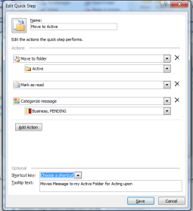
Quick Steps
Quick Steps performs several popular actions for emails with a click or tap,
The Quick Steps box/pane is on the email’s Home Tab,
Quick Steps actions include:
Moving and categorizing emails,
Creating and using an email group,
Forwarding emails to a person or group.
Notes:
Quick Steps
Here’s how to set-up a Quick Step for moving a message and assigning a category to the message.
In the Home Tab of your Email object, Click the Dialogue Box launcher arrow or the See More arrow and from the menu choose New Quick Step and then Click Move to Folder.
At the First Time Setup Box click the Options button at the bottom of the pane.
The Edit Quick Step pane appears. Name your Quick Step – I am moving a selected message(s) to my Active folder.
Next you may change your action or keep the Move to folder action,
Next, click in the box under the action to choose your folder you may need to navigate or browse to find the folder you wish if it is not in the list by choosing the other folder item in your list.
Select the folder you wish to move the message to and Click OK.
I am keeping the Mark as Read item then I am creating another action to assign the message to categories. You may add other actions, too.
You may use a shortcut key to perform the action, too, by assign the Quick Step to one of the shortcut keys in the list.
I am providing a Tooltip text describing my Quick Step action as well.
Click Save.

Slide 23
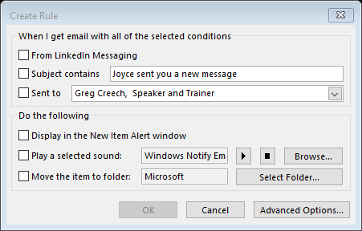
Rules
Rules affect messages as they come in based on sender, subjects, and many other criteria,
The Rules button and menu are on the Home Tab of email,
The Rules Wizard may guide you in creating a rule,
You may edit, add, and delete rules using the Manage Rules and Alerts pane,
Helpful in moving messages to folders before they clog up your Inbox.
Notes:
Rules
Let’s create a rule for Outlook to take action from a specific sender.
If you create a rule that doesn’t work the way you intend you can edit or delete the rule.
Select an email message from a sender that you wish to create a rule.
Click the Create Rule icon or with your message selected, right click the message and the shortcut menu appears with Rules and you may click the Create Rule item.
The Create Rule dialogue box appears. Review this screen and determine your rules for when you receive a message from your sender Clicking the Select Folder . . . displays your folders to select which folder you would like to move messages.
Select your options in the Create Rule pane. Choose your folder if necessary and decide if you want to display a New Item Alert and notification sound, which you may change for this rule using the Browse button in the Play a selected sound section.
Click OK and your messages will move when you get a message from that person.
Outlook provides the Success screen. You may run this rule to move all messages from this person to another folder automatically by having the check box marked.
Click OK.

Slide 24
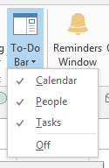
Outlook: To-Do Bar Enhancements
The To-Do bar is in the View tab and activates for each Outlook object - Mail, People, Calendar,
You may set different options for each Outlook object to view Calendar, People, or Tasks,
The To-Do bar offers an At-A-Glance look of your calendar appointments, people, and tasks,
You may quickly open an item by double clicking on it,
You may navigate to different months with your calendar displayed.
Notes:
The Design Tab in Word affects your entire document and the new Paragraph Spacing Dialogue box appears below. Changing the paragraph spacing here or inserting a watermark updates your file for you. You may create your own custom theme for headings, colors, fonts, and other elements. You may create you own color and font schemes as well using the Design tab and associated command buttons.

Slide 25
Open in New Window
The Open in New Window button in the View Tab allows you to view two or more folders or items,
Particularly helpful with viewing your calendar and inbox side-by-side,
Prevents toggling between Outlook objects,
Using the Windows Snap feature you may view two or more Outlook items on your desktop.
Notes:
Using Open in New Window
The Open in New Window button in the View Tab allows you to view two or more folders or items,
Particularly helpful with viewing your calendar and inbox side-by-side,
Prevents toggling between Outlook objects,
Using the Windows Snap feature you may view two or more Outlook items on your desktop.
In your Inbox, click the Open In New Window button on the View Tab (Outlook opens a second occurrence of your Inbox,
In the new Inbox window, click your Calendar in the Folders Pane (Outlook opens your calendar in the window),
Using the Windows Snap feature view your Inbox and Calendar Side-by-Side.

Slide 26
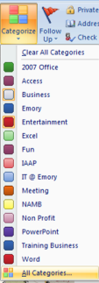
Categories
Categories organize Outlook items using color and text,
You may categorize any Outlook item,
You may create your own categories using color and text to keep you organized,
One Outlook item may have several categories,
Views and the View Tab in Outlook provides terrific views by category,
Color codes your calendar.
Notes:
Using Categories
Open a Contact and in the Contact Tab, click the Categories button in the Tags Group. You should and may assign a contact to multiple categories for tracking and grouping.
To assign a Category simply click one or more of your color items. Assign yourself to several Categories. Your category name and color appear at the top of your contact. You can create, edit, and delete category choices by clicking the All Categories button.
Let’s create your own Category.
Click the All Categories. . . button and the Color Categories pane appears.
Click the New button and Add a New Category as I am accomplishing for Outlook. Type your New Category Name, choose a color and assign a Shortcut key if you like.
Click OK for Outlook to accept and use your new category.
You can select a Category and Delete it or you may Rename a Category using the Rename button.
Click OK to exit the Color Categories Pane. Click the Save and Close Button for your Contact or Calendar item you are using Categories. Now, you may use your category on any Outlook item.

Slide 27
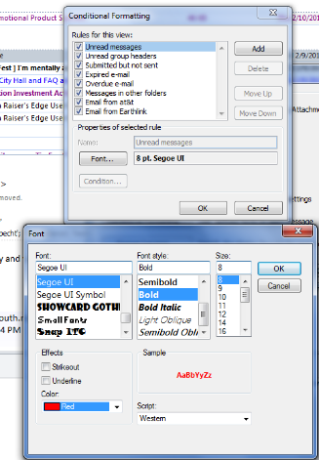
Conditional Formatting
Conditional formatting is in the View Tab, View Settings, and the Conditional Format button in the Advanced View Settings pane,
Color codes messages based on criteria,
You may change the font formatting for New Messages and other built-in Outlook format,
You may provide special font formatting for messages based on the sender, subject, and other criteria.
Notes:
Using Email Conditional Formatting
You should have your Email and Inbox in view.
Click the View Tab and Click the View Settings Button.
The Advance View Settings Message Pane opens.
Click Conditional Formatting and the Conditional Formatting Pane opens. There are several formats that Outlook uses by default, such as your unread messages being bold. With my Unread messages selected, I clicked the Font button to change my formatting so my unread messages will use the color red and include the bold.
I have added new Conditional Formatting that once I read a message the message unbolds but changes color based on the account that I received the message
I created the new Conditional Formatting by clicking the Add button at the Conditional Formatting pane. I gave the action a name, changed my font to purple, and then clicked the condition button and from the filter pane entered the criteria for the formatting. I clicked OK several times and any messages from this account the font turned purple.
You may set all types of formatting based on who the message is from, accounts, and many choices.

Slide 28
Thank you!
Love my accountant, Lynn, the Goddess of my Numbers,
Thank you –everyone! You are the best,
OK – One Unabashed, shameless, self-promotion slide!
I appreciate you and the work you do,
gregcreech.biz or gregcreech.com
Thanks for our time!

